Slide 1

Notes:
PowerPoint made by Teresa Cremin and the RfP Team for The Open University’s research-informed reading for pleasure development work.
Please respect the copyright of the visuals and the slides and do not alter these slides, though do feel free to insert your own.
There are further PowerPoints on the site to support the profession which can be used in the same way.
Visit our website: OU RfP Reading for Pleasure Website

Slide 2
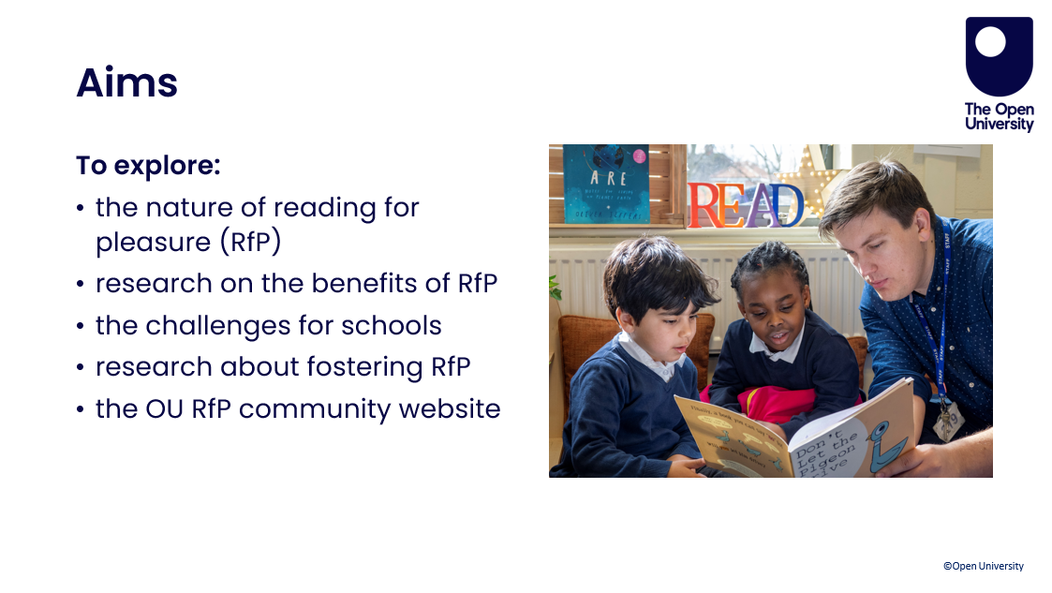
Notes:
PowerPoint made by Teresa Cremin and the RfP Team for The Open University’s research-informed reading for pleasure development work.
Please respect the copyright of the visuals and the slides and do not alter these slides, though do feel free to insert your own.
There are further PowerPoints on the site to support the profession which can be used in the same way.

Slide 3

Notes:
PowerPoint made by Teresa Cremin and the RfP Team for The Open University’s research-informed reading for pleasure development work.
Please respect the copyright of the visuals and the slides and do not alter these slides, though do feel free to insert your own.
There are further PowerPoints on the site to support the profession which can be used in the same way.

Slide 4
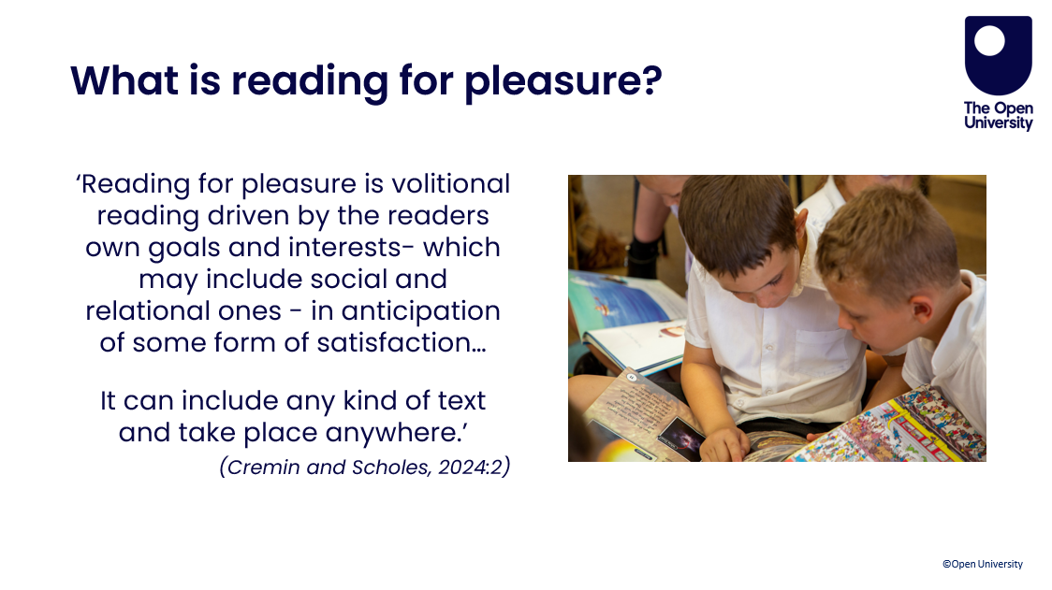
Notes:
PowerPoint made by Teresa Cremin and the RfP Team for The Open University’s research-informed reading for pleasure development work.
Please respect the copyright of the visuals and the slides and do not alter these slides, though do feel free to insert your own.
There are further PowerPoints on the site to support the profession which can be used in the same way.

Slide 5
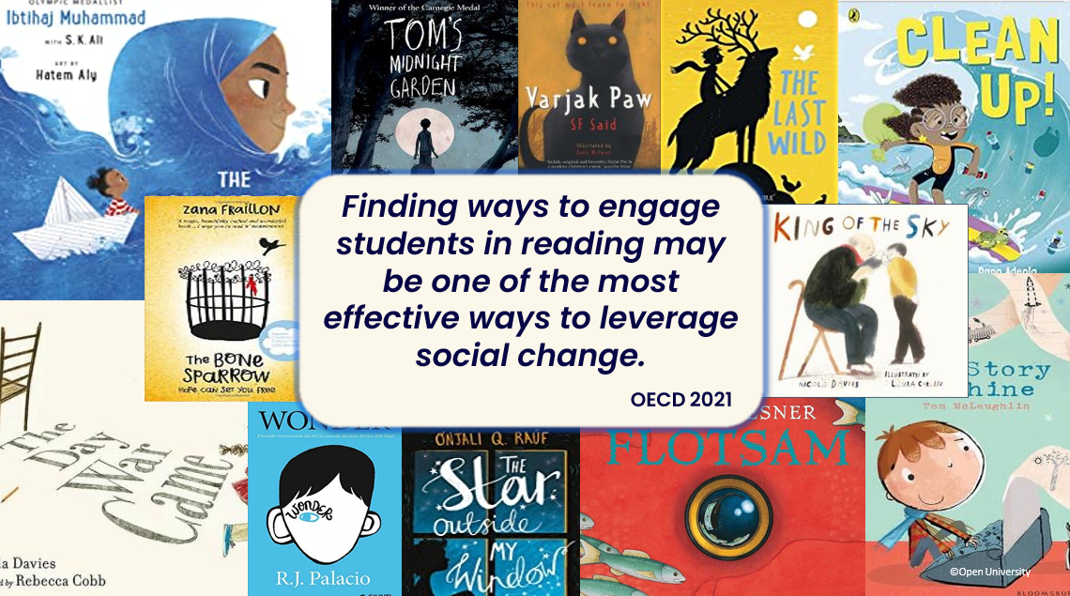
Notes:
PowerPoint made by Teresa Cremin and the RfP Team for The Open University’s research-informed reading for pleasure development work.
Please respect the copyright of the visuals and the slides and do not alter these slides, though do feel free to insert your own.
There are further PowerPoints on the site to support the profession which can be used in the same way.

Slide 6
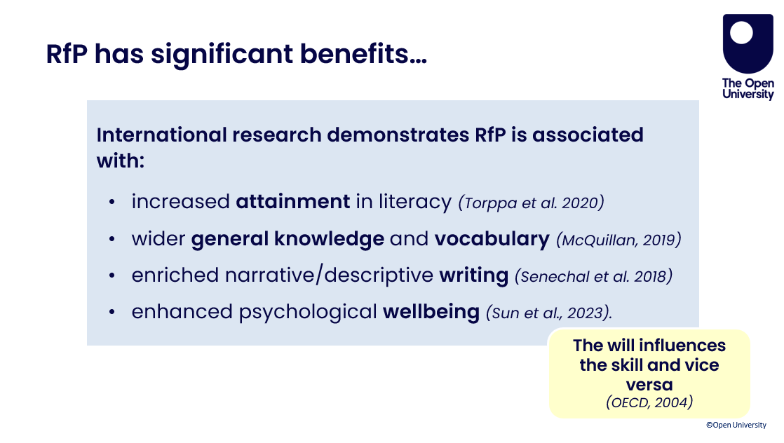
Notes:
PowerPoint made by Teresa Cremin and the RfP Team for The Open University’s research-informed reading for pleasure development work.
Please respect the copyright of the visuals and the slides and do not alter these slides, though do feel free to insert your own.
There are further PowerPoints on the site to support the profession which can be used in the same way.

Slide 7
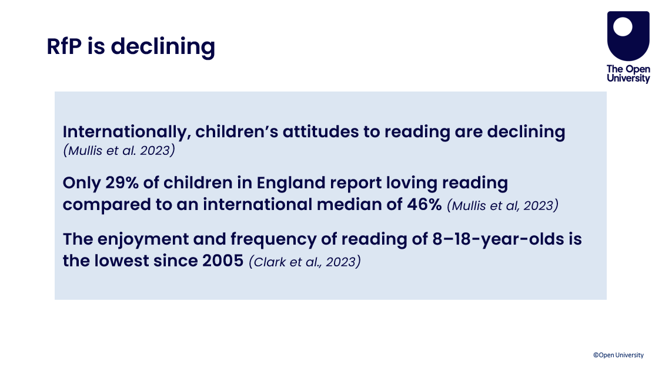
Notes:
PowerPoint made by Teresa Cremin and the RfP Team for The Open University’s research-informed reading for pleasure development work.
Please respect the copyright of the visuals and the slides and do not alter these slides, though do feel free to insert your own.
There are further PowerPoints on the site to support the profession which can be used in the same way.

Slide 8
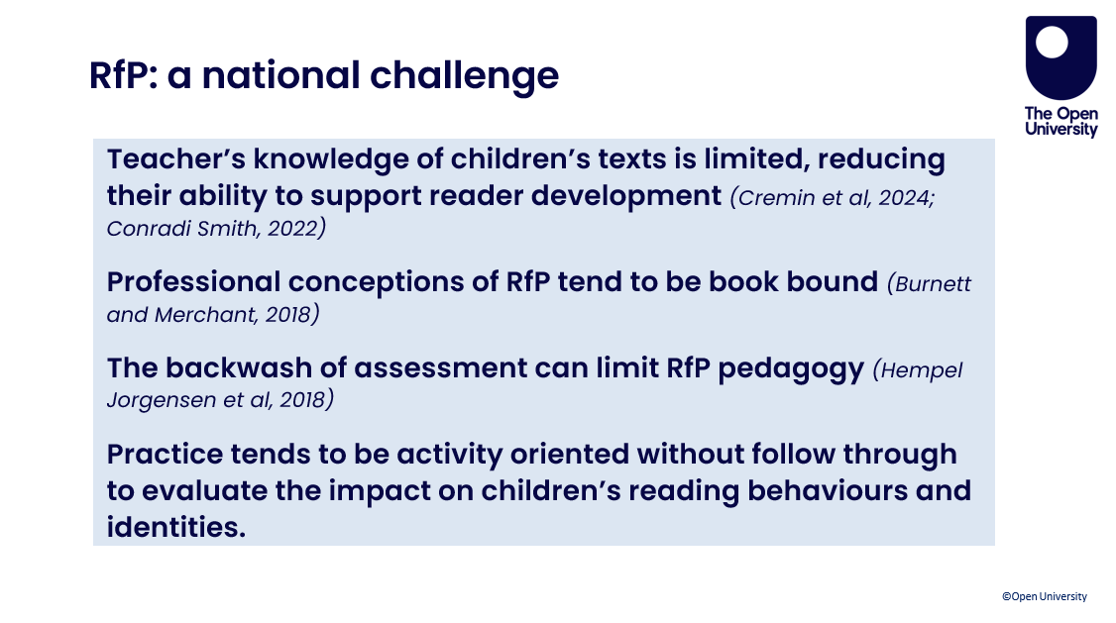
Notes:
PowerPoint made by Teresa Cremin and the RfP Team for The Open University’s research-informed reading for pleasure development work.
Please respect the copyright of the visuals and the slides and do not alter these slides, though do feel free to insert your own.
There are further PowerPoints on the site to support the profession which can be used in the same way.

Slide 9
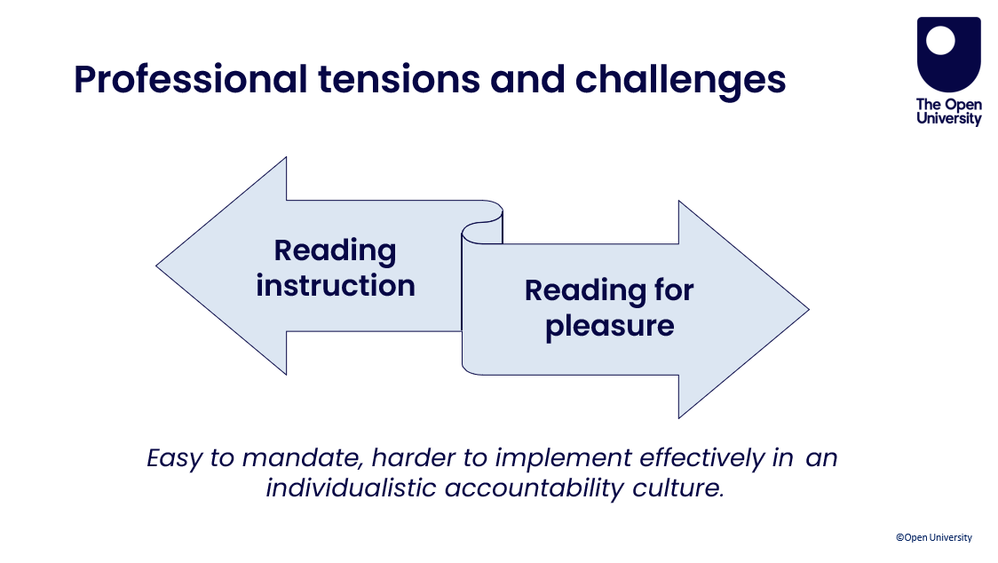
Notes:
PowerPoint made by Teresa Cremin and the RfP Team for The Open University’s research-informed reading for pleasure development work.
Please respect the copyright of the visuals and the slides and do not alter these slides, though do feel free to insert your own.
There are further PowerPoints on the site to support the profession which can be used in the same way.

Slide 10
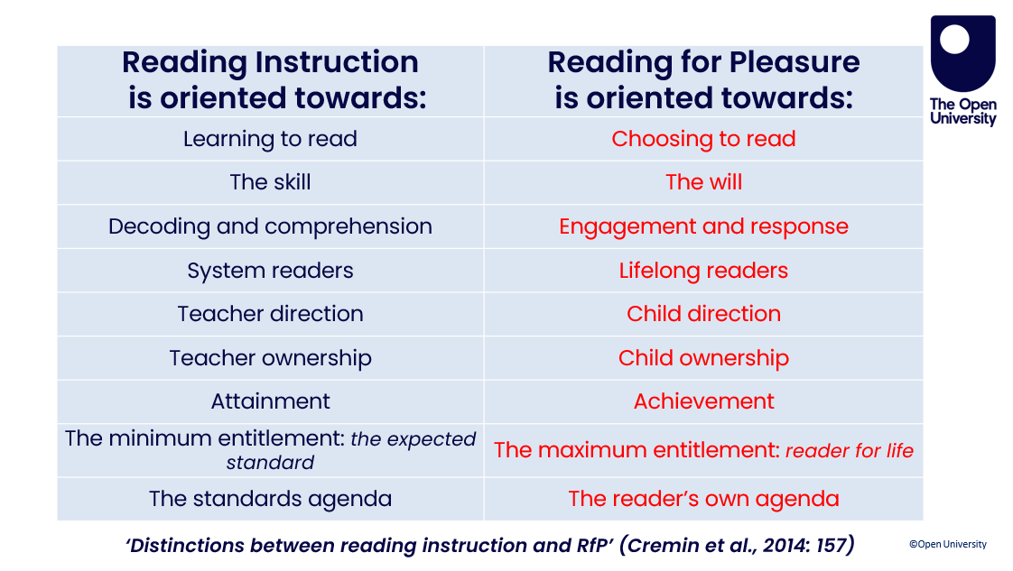
Notes:
PowerPoint made by Teresa Cremin and the RfP Team for The Open University’s research-informed reading for pleasure development work.
Please respect the copyright of the visuals and the slides and do not alter these slides, though do feel free to insert your own.
There are further PowerPoints on the site to support the profession which can be used in the same way.

Slide 11
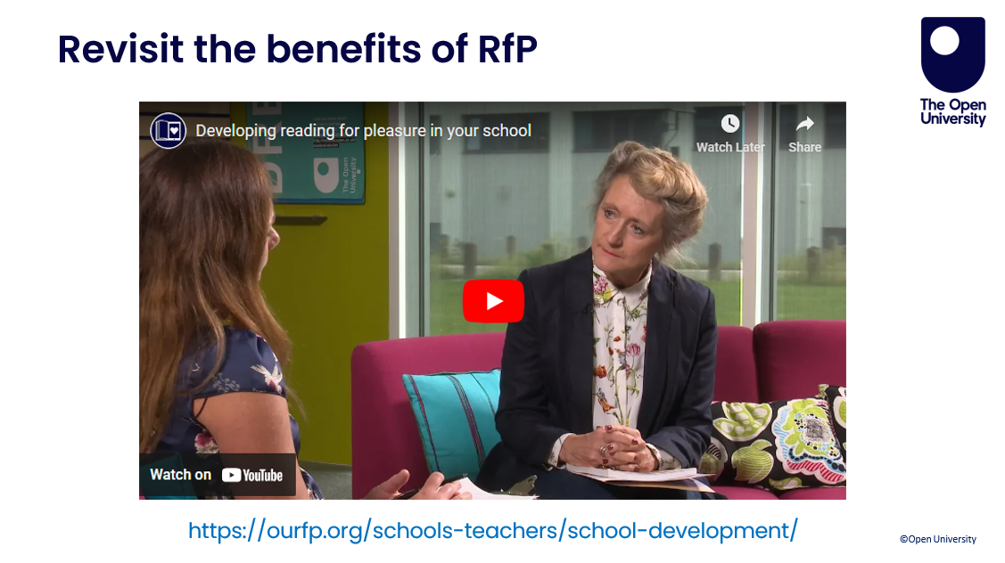
Notes:
PowerPoint made by Teresa Cremin and the RfP Team for The Open University’s research-informed reading for pleasure development work.
Please respect the copyright of the visuals and the slides and do not alter these slides, though do feel free to insert your own.
There are further PowerPoints on the site to support the profession which can be used in the same way.
https://ourfp.org/schools-teachers/school-development/

Slide 12
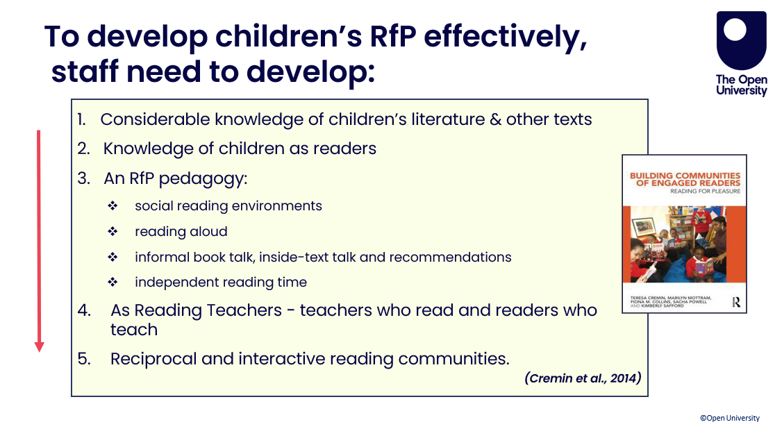
Notes:
PowerPoint made by Teresa Cremin and the RfP Team for The Open University’s research-informed reading for pleasure development work.
Please respect the copyright of the visuals and the slides and do not alter these slides, though do feel free to insert your own.
There are further PowerPoints on the site to support the profession which can be used in the same way.

Slide 13
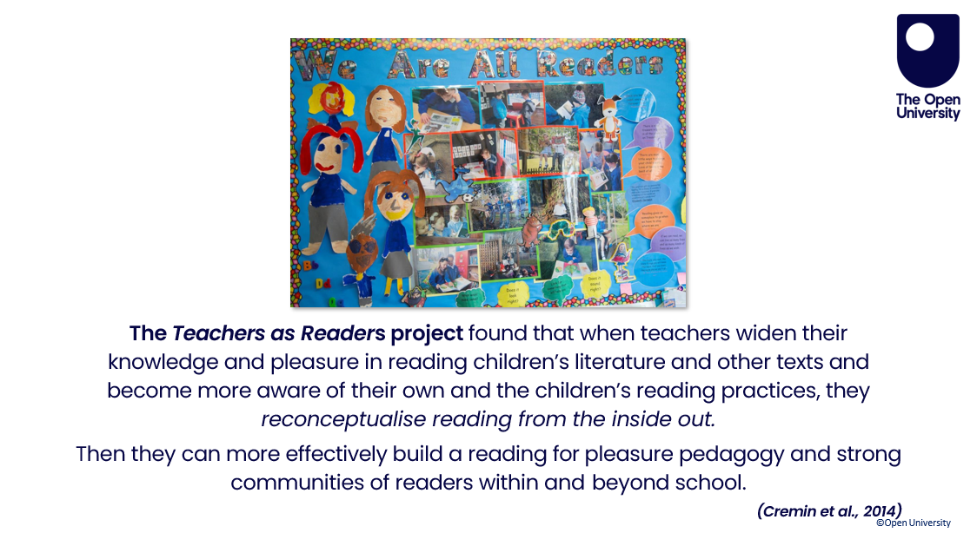
Notes:
PowerPoint made by Teresa Cremin and the RfP Team for The Open University’s research-informed reading for pleasure development work.
Please respect the copyright of the visuals and the slides and do not alter these slides, though do feel free to insert your own.
There are further PowerPoints on the site to support the profession which can be used in the same way.

Slide 14
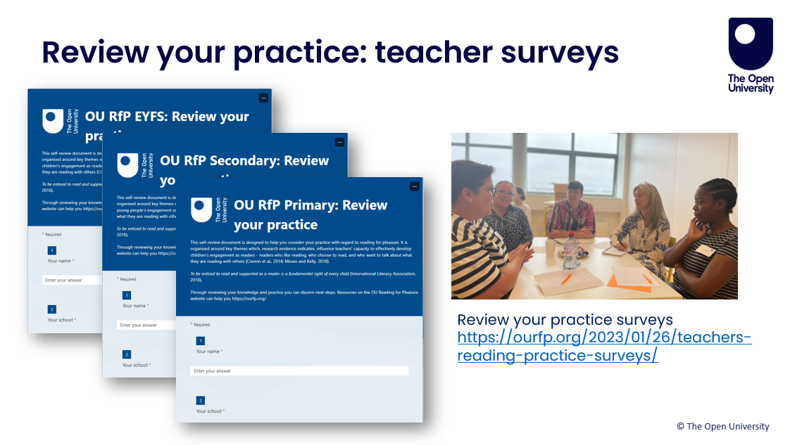
Notes:
PowerPoint made by Teresa Cremin and the RfP Team for The Open University’s research-informed reading for pleasure development work.
Please respect the copyright of the visuals and the slides and do not alter these slides, though do feel free to insert your own.
There are further PowerPoints on the site to support the profession which can be used in the same way.
Review your practice surveys: https://ourfp.org/2023/01/26/teachers-reading-practice-surveys/

Slide 15
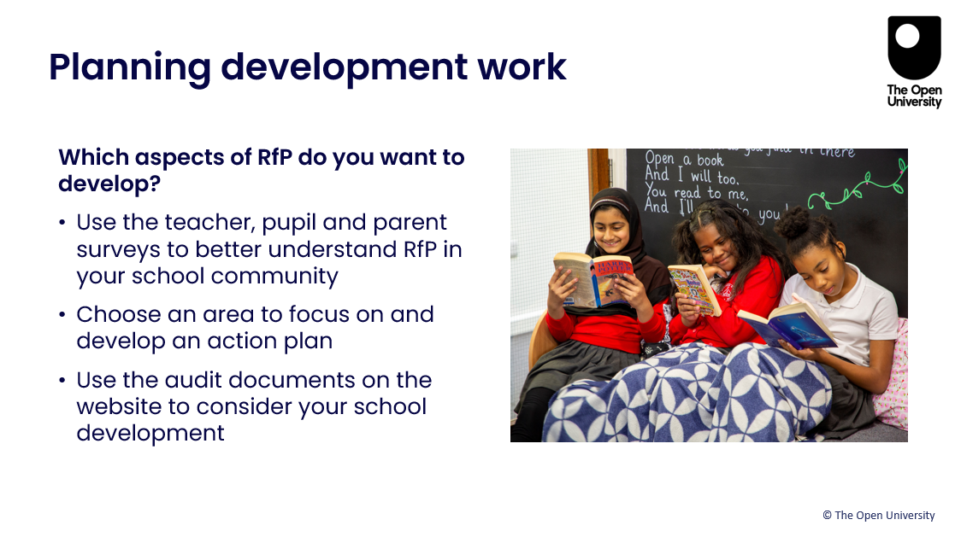
Notes:
PowerPoint made by Teresa Cremin and the RfP Team for The Open University’s research-informed reading for pleasure development work.
Please respect the copyright of the visuals and the slides and do not alter these slides, though do feel free to insert your own.
There are further PowerPoints on the site to support the profession which can be used in the same way.

Slide 16

Notes:
PowerPoint made by Teresa Cremin and the RfP Team for The Open University’s research-informed reading for pleasure development work.
Please respect the copyright of the visuals and the slides and do not alter these slides, though do feel free to insert your own.
There are further PowerPoints on the site to support the profession which can be used in the same way.
Visit our website: OU RfP Reading for Pleasure Website

Slide 17

Notes:
PowerPoint made by Teresa Cremin and the RfP Team for The Open University’s research-informed reading for pleasure development work.
Please respect the copyright of the visuals and the slides and do not alter these slides, though do feel free to insert your own.
There are further PowerPoints on the site to support the profession which can be used in the same way.
Visit our website: OU RfP Reading for Pleasure Website

Slide 18
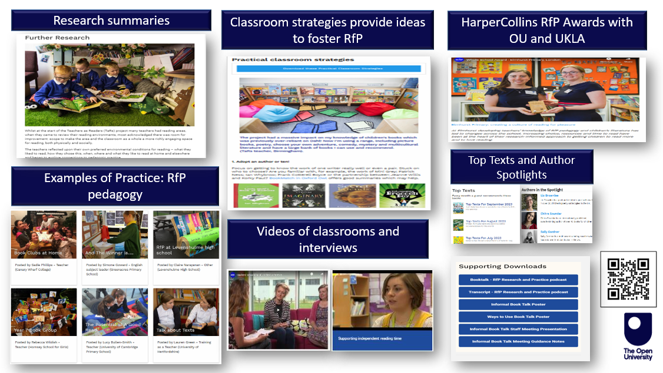
Notes:
PowerPoint made by Teresa Cremin and the RfP Team for The Open University’s research-informed reading for pleasure development work.
Please respect the copyright of the visuals and the slides and do not alter these slides, though do feel free to insert your own.
There are further PowerPoints on the site to support the profession which can be used in the same way.
Visit our website: OU RfP Reading for Pleasure Website

Slide 19

Notes:
PowerPoint made by Teresa Cremin and the RfP Team for The Open University’s research-informed reading for pleasure development work.
Please respect the copyright of the visuals and the slides and do not alter these slides, though do feel free to insert your own.
There are further PowerPoints on the site to support the profession which can be used in the same way.
Visit our website: OU RfP Reading for Pleasure Website

Slide 20

Notes:
PowerPoint made by Teresa Cremin and the RfP team for The Open University’s research-informed reading for pleasure development work.
Please respect the copyright of the visuals and the slides and do not alter these slides, though do feel free to insert your own.
There are further PowerPoints on the site to support the profession which can be used in the same way.
Visit our website: OU RfP Reading for Pleasure Website

Slide 21
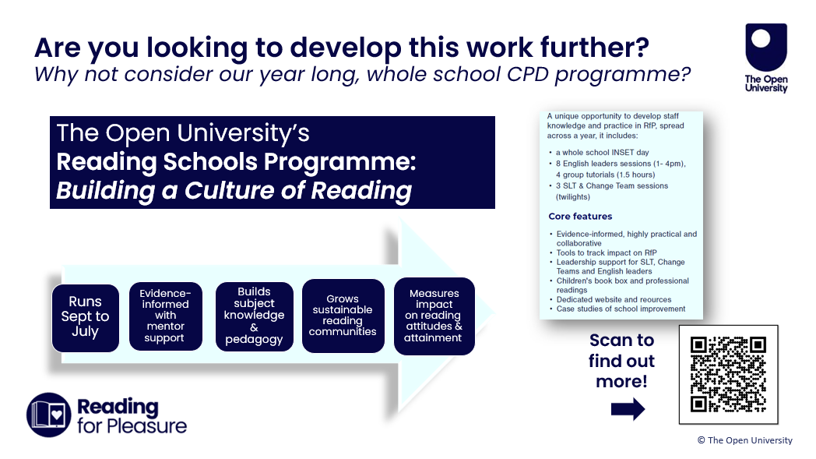
Notes:
PowerPoint made by Teresa Cremin and the RfP team for The Open University’s research-informed reading for pleasure development work.
Please respect the copyright of the visuals and the slides and do not alter these slides, though do feel free to insert your own.
There are further PowerPoints on the site to support the profession which can be used in the same way.
https://ourfp.org/schools-teachers/reading-schools-programme/

Slide 22
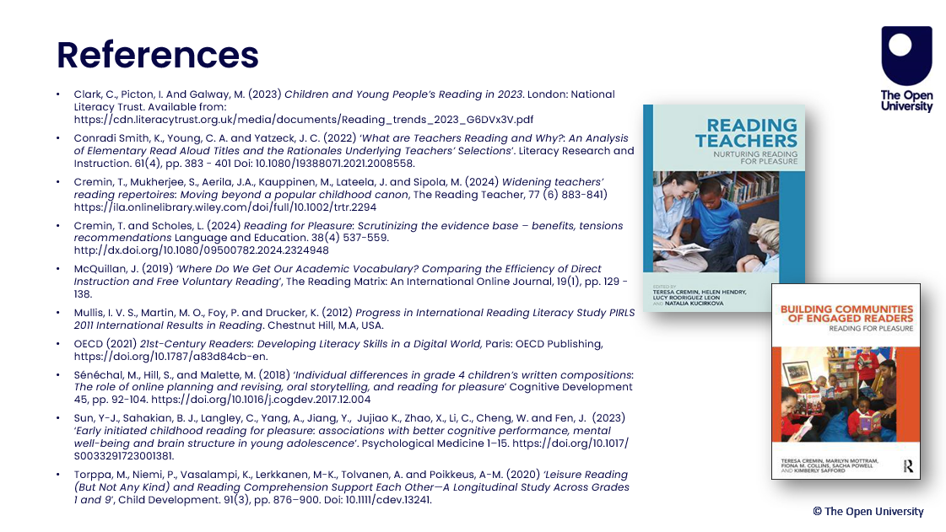
Notes:
PowerPoint made by Teresa Cremin and the RfP Team for The Open University’s research-informed reading for pleasure development work.
Please respect the copyright of the visuals and the slides and do not alter these slides, though do feel free to insert your own.
There are further PowerPoints on the site to support the profession which can be used in the same way.

